Slide 1
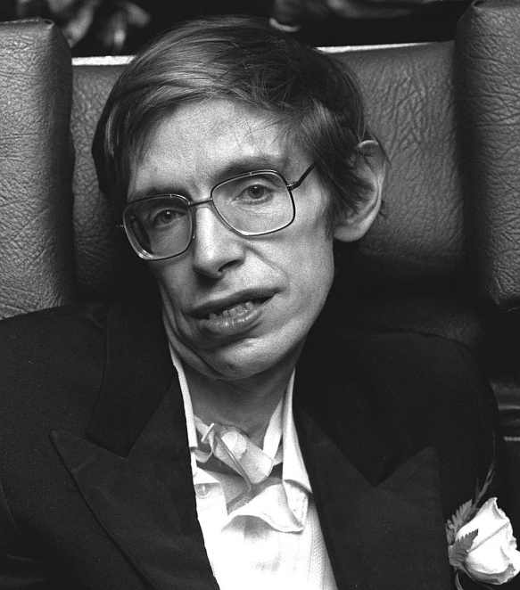
Stephen William Hawking
January 8, 1942 - March 14, 2018

Slide 2
Stephen William Hawking
I want to tell you about a very famous scientist - Stephen Hawking. He was a theoretical physicist and cosmologist.
He was born in 1942 in England and died in 2018. He was a very inspiring person, an example of how a disabled man can do so much for the whole humanity.
He was studying the laws by which the universe is governed. He managed to predict theoretically that black holes emit radiation. For his contribution to the theory of cosmology he received numerous awards.
Hawking was a public person. He put a lot of effort to explain scientific discoveries to a wide audience. He wrote books and essays, gave interviews, and participated in VT-shows.

Slide 3
Stephen William Hawking
The film about the scientist “The Theory of Everything” was made in 2014. This film shows what a brave, strong and dedicated woman his wife Jane was. Stephen's disease was diagnosed when he was 21, and doctors said he would live only a couple of years with his illness. But Jane wanted to marry him anyway.
As the motor neuron disease was progressing Hawking was losing his physical abilities: he had to use wheelchair and his speech deteriorated. He couldn’t even get dressed without assistance. For a long time they couldn’t afford to hire a nurse and Jane helped him with everything. She took care of Stephen and their 3 kids.

Slide 4
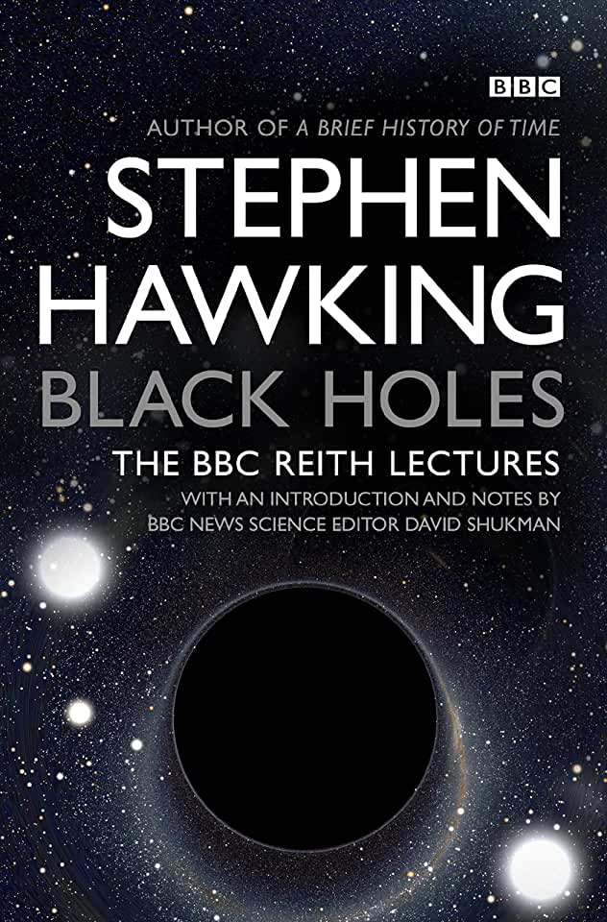
Stephen William Hawking
Major Works
Hawking’s main focus of research was in the field of theoretical cosmology, focusing on the evolution of the universe as governed by the laws of general relativity. His most important work is believed to be the study of 'Black Holes.'

Slide 5
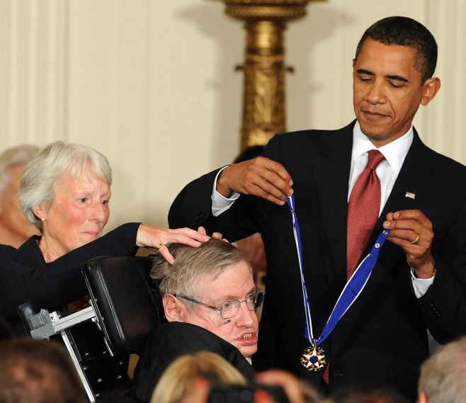
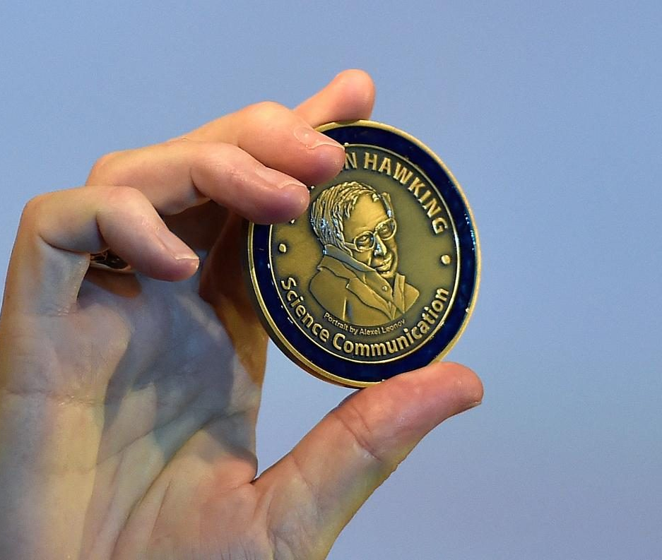
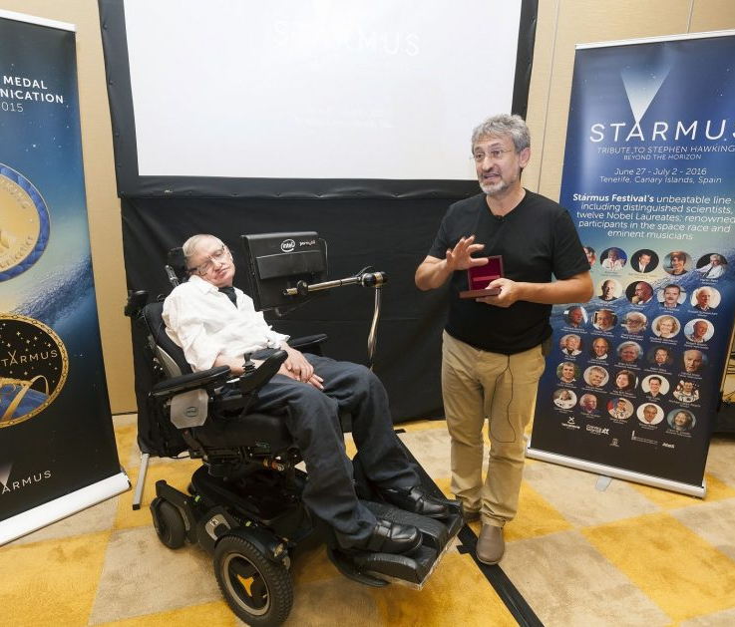
Stephen William Hawking
Awards & Achievements
Hawking became a 'Commander of the Order of the British Empire' in 1982. He was later honored with many prestigious awards like 'the Gold Medal of the Royal Astronomical Society,' 'the Paul Dirac Medal,' etc.
Other notable honors bestowed upon Hawking include 'the Wolf Prize,' 'Companion of Honor by Her Highness,' 'Julius Edgar Lilienfeld Prize,' 'the Copley Medal,' 'the Presidential Medal of Freedom,' 'the Russian Fundamental Physics Prize,' etc.

Slide 6
Stephen William Hawking
Personal Life & Legacy
He met his first wife, Jane Wilde, a friend of his sister, shortly before the diagnosis of his illness. The couple got married in 1965. They had three children together: Robert, Lucy, and Timothy. Jane was a pillar of strength for Hawking in the beginning of their marriage, but with his regressing physical condition and increasing global popularity, their marriage became a big burden on Jane and stress started to brew in their relationship.
During the late 1980, Hawking had a romantic affair with one of his nurses, Elaine Manson, and left Jane for her. He divorced Jane and married Manson in 1995. Their marriage proved to be detrimental to Hawking’s family life and he largely kept away from his children.
Hawking’s physical condition increasingly began to deteriorate. He could no longer drive his wheelchair; he required a ventilator at times and was hospitalized several times since 2009. He was closely working with researchers on systems that could translate his brain patterns into switch activations.

Slide 7
Stephen William Hawking
To honour his contribution, several museums and buildings have been named after him. These are 'Stephen W. Hawking Science Museum' in San Salvador, El Salvador; the 'Stephen Hawking Building' in Cambridge, and the 'Stephen Hawking Centre' at the Perimeter Institute in Canada.
He participated in zero-gravity flight in a ‘Vomit Comet,' courtesy of 'Zero Gravity Corporation,' and experienced weightlessness eight times in 2007.
Jane met organist Jonathan Hellyer Jones while singing in a church choir in 1977 and developed a romantic relationship, but Hawking did not object to it saying that as long as she loved him, he had no problems with their platonic relationship.
He appeared on the famous American sitcom, ‘Big Bang Theory.'

