Slide 1
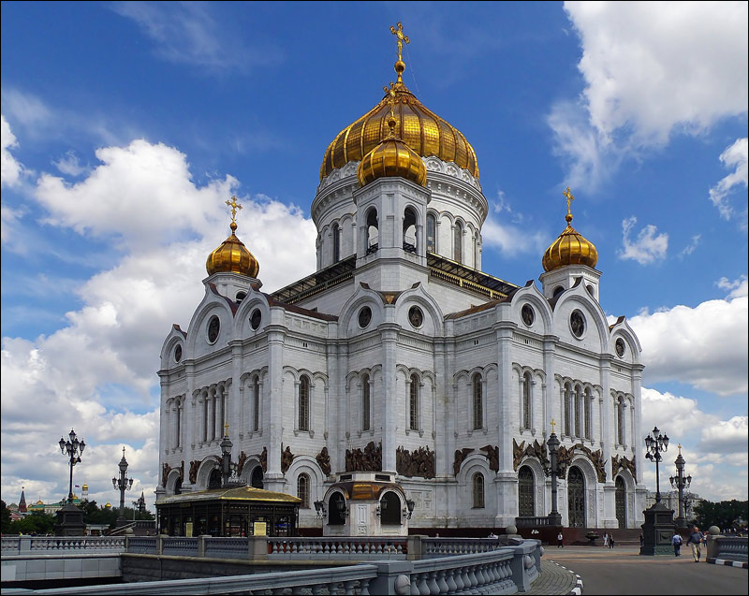
Cathedral of Christ the Savior

Slide 2
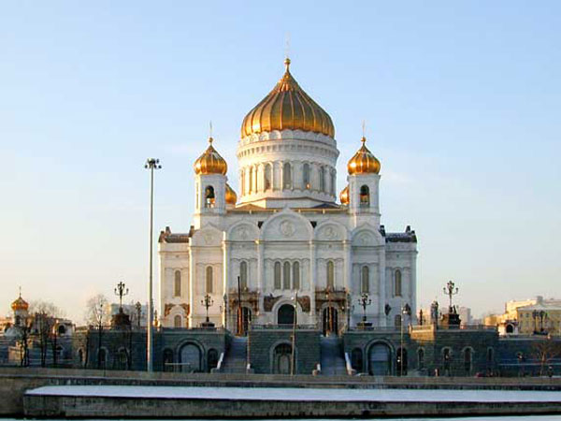
History of creation
The Cathedral of Christ the Savior in Moscow was built as gratitude to God for help during a difficult period in the history of Russia - during the Patriotic War of 1812. This is a monument to the Russian people for their courage and heroism.

Slide 3
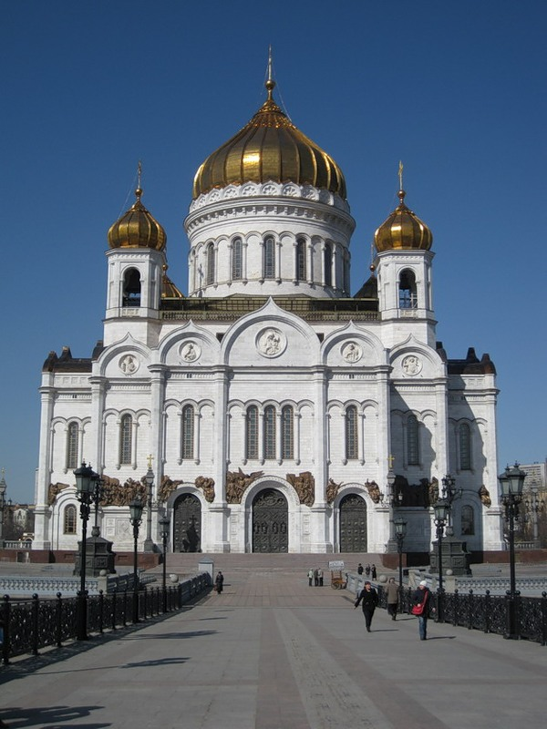
Construction of the temple
Soon the soil of the mountains began to settle under the weight of the structure being erected. Nicholas I, who took the throne after Alexander I, found Witberg's project unfeasible. In 1832, Konstantin was appointed architect.
They decided to start construction not far from the Kremlin, on the site of the former Alekseevsky Convent, which they decided to demolish.

Slide 4
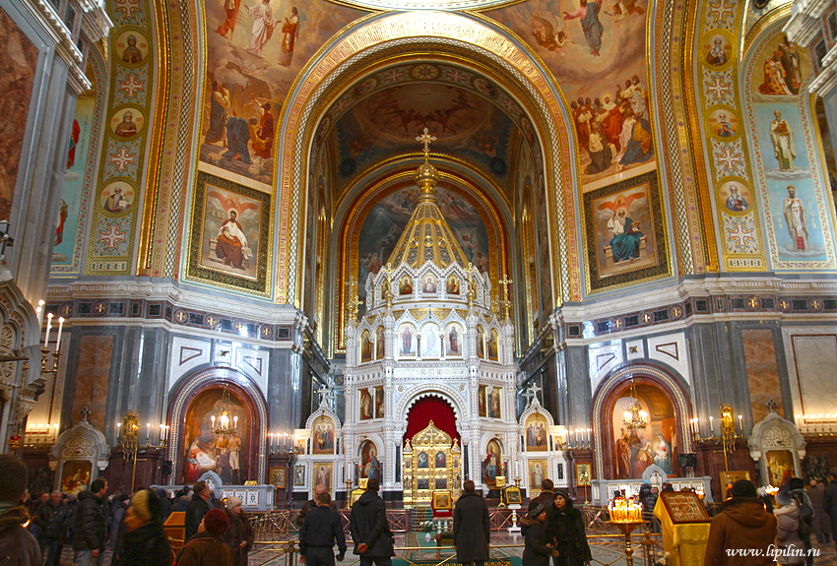
Temple decoration
The interior decoration was famous for its paintings. The famous Russian painters of the Russian Academy of Arts V. Vereshchagin and V. Surikov, Baron T. Neff and I. Kramskoy worked on them. The area of ​​painting of the shrine is more than 22,000 square meters. meters, of which more than 9000 sq. meters - this is gilding with gold leaf.

Slide 5
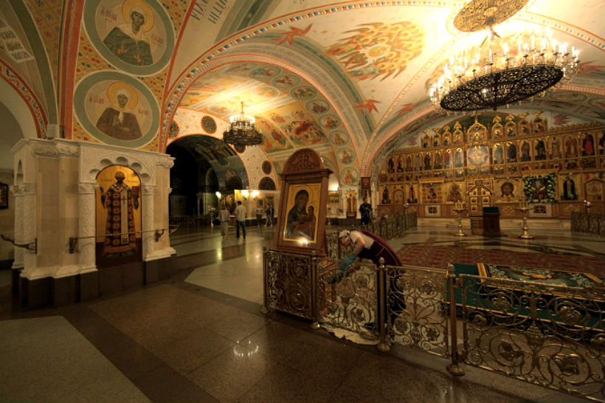
On the walls of the gallery located along the perimeter of the building, marble plaques were installed with a list of all the battles of the Russian army, the names of military leaders and distinguished officers and soldiers. Sculpture and painting depict all the mercies of the Lord, sent down through the prayers of the righteous to the Russian kingdom. The paths that the Lord chose for salvation are also depicted.

Slide 6
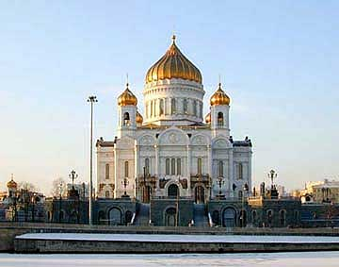
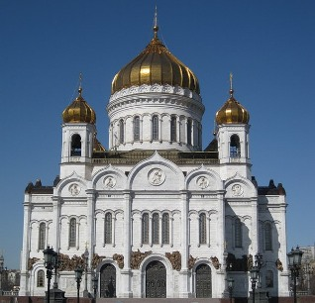
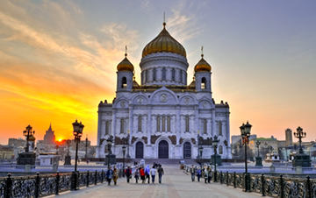
Cathedral of Christ the Savior in Moscow
more like a huge museum,
The design of which tells us about history
an entire era of the Russian state and the courage of its people. It is a memorial to Russian military glory, a monument to all who died for their Motherland.

