Slide 1
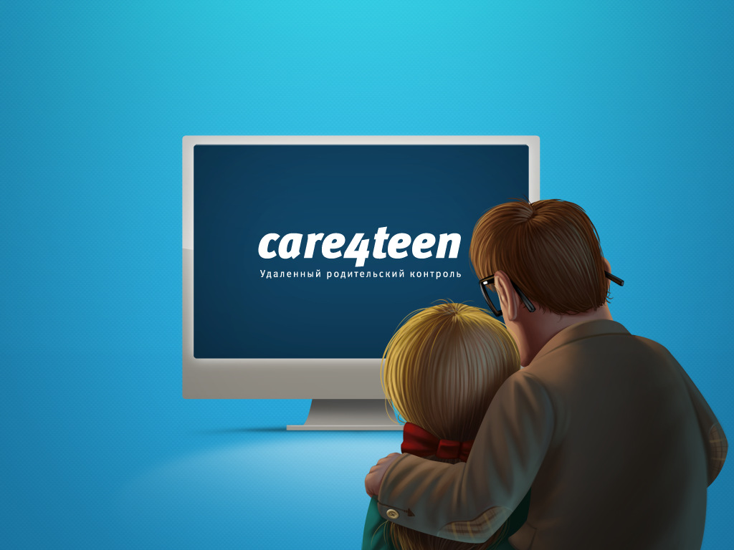
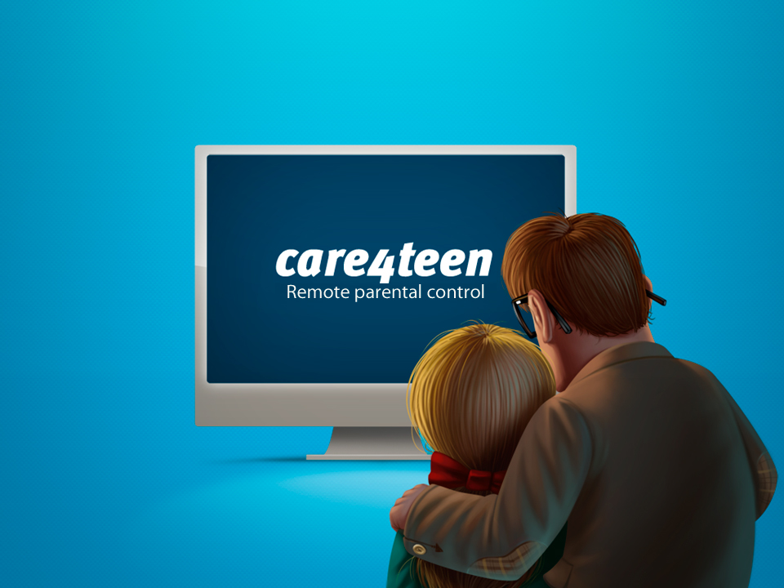

Slide 2
Using our service parents can always be closer to their children
- Remote viewing reports
- About visited sites
- Running applications, games
- Remote settings
- Prohibition of launch games or applications
- Blocking sites

Slide 3
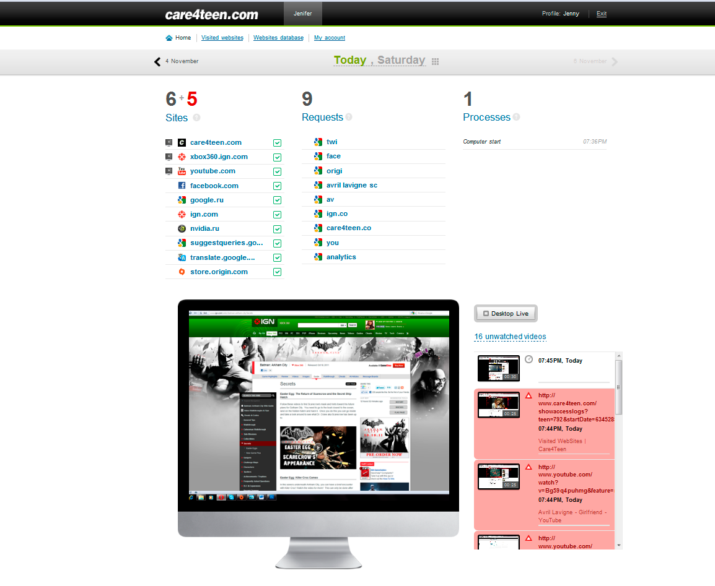
Convenient internal interface

Slide 4
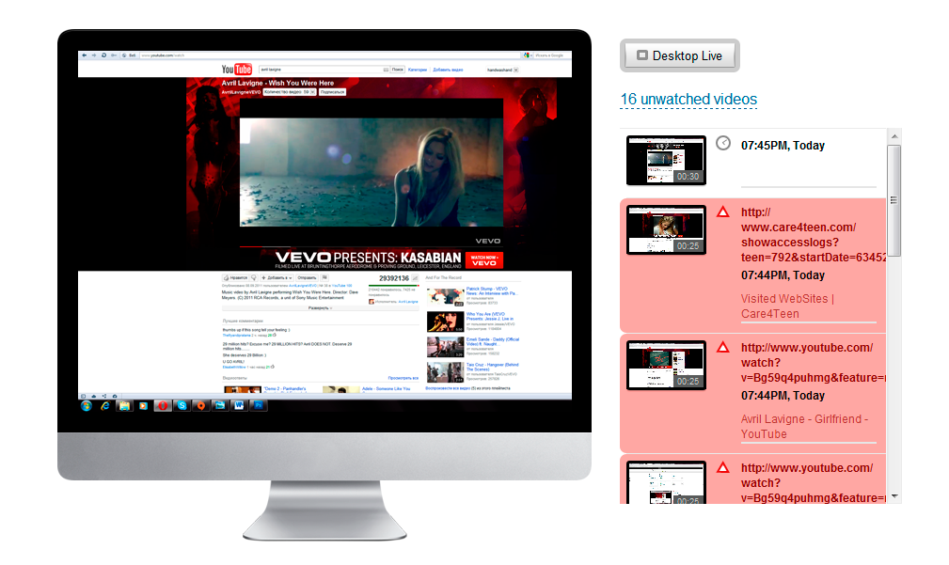
Video reports and broadcast video from child’s screen in the real time

Slide 5
Care4teen is the global parental control.

Slide 6
Care4teen is the social service.
Parents make lists of allowed sites and block unwanted.
Parents can join into the group of people with similar views on network security.

Slide 7
Market
More than 200 million potential users computers, iPhone, android

Slide 8
Competition
Netnanny
McAfee Family Protection
PureSight PC
Various system built-in in antivirus.

Slide 9
Our advantage
Programs - competitors have changed little over the past decade.
care4teen – it’s a totally different approach to the safety of children on the Internet.

Slide 10
Business model
Freemium – It’ll be free available to a limited set of functions of the program. Full functionality of the program will be cost 15 $ per month.
Targeting advertising. We’ll show ads for parents based on the preferences of the child.

Slide 11
Marketing
- search engine optimization
adwords, Microsoft Advertising
advertising on line resources
affiliate programs
social promotion in Twitter, on Facebook

Slide 12
Current status and plans
We’ve a version for Windows
In the current development of software the version for iPhone, Android
Further plans
Care4business is the version for business
Care4education is the version for educational institutions

Slide 13
Team
Alexander Borisov CEO
Yuri Mosha Business consultant
Kate Miller Marketing manager
Vitaly Tatarinov Technical director
Andrey Besyasychny Main developer

