Slide 1
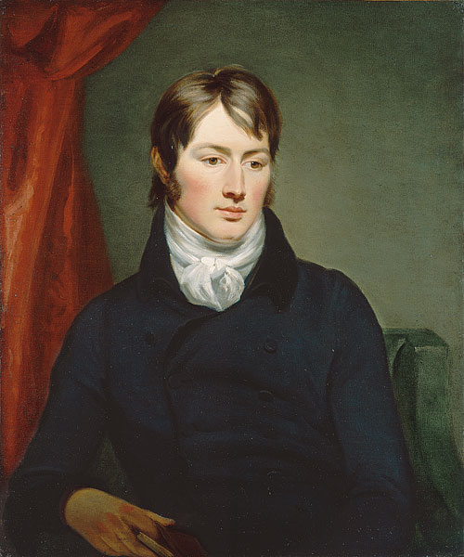
John Constable

Slide 2
Glossary
a county - графство a wealthy miller - зажиточный мельник a mill - мельница exhibitions - выставки " The Hay Wain" - "Телега для сена" "Arable Land" - "Пашня" plowing – пахота

Slide 3
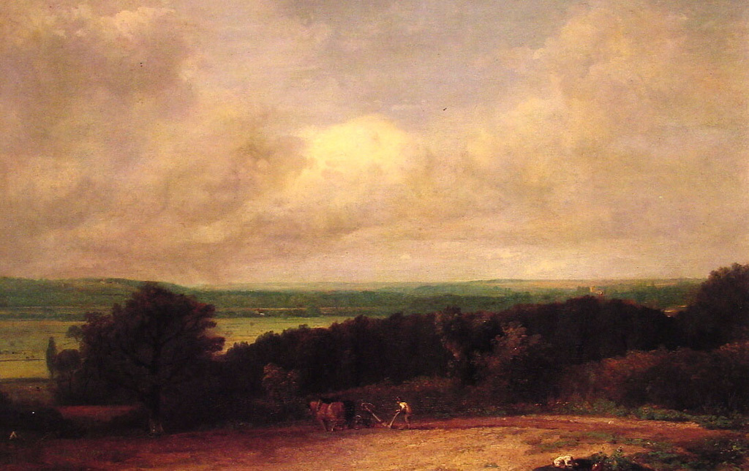
Landscape. Plowing scene in Suffolk

Slide 4
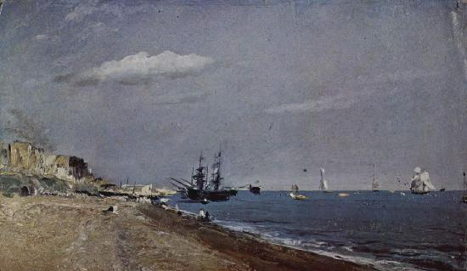
Sea coast with sailboats in Brighton

Slide 5
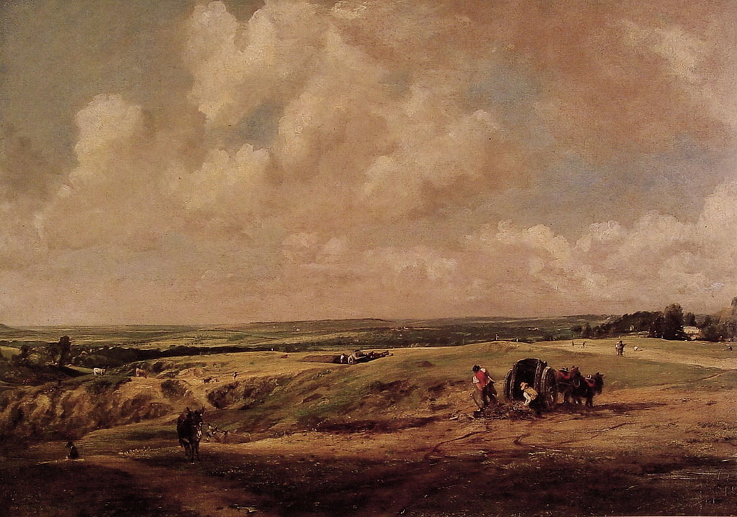
Hampstead Heath

Slide 6
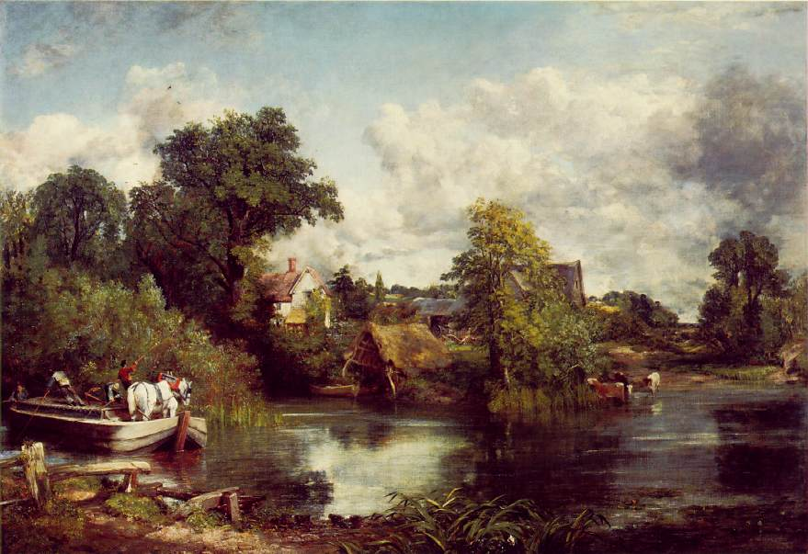
White Horse

Slide 7
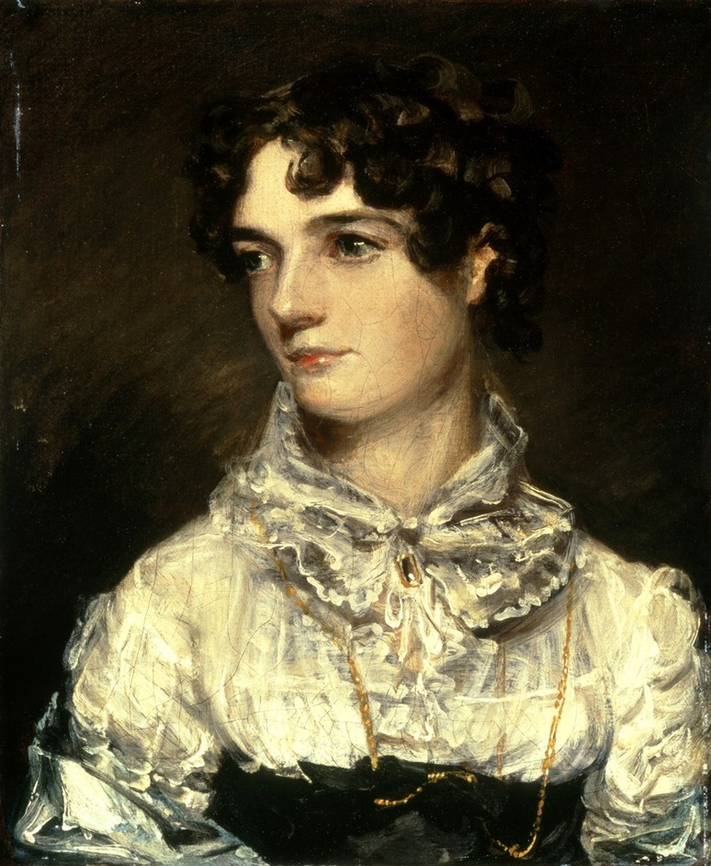
Mary Bicknell

Slide 8
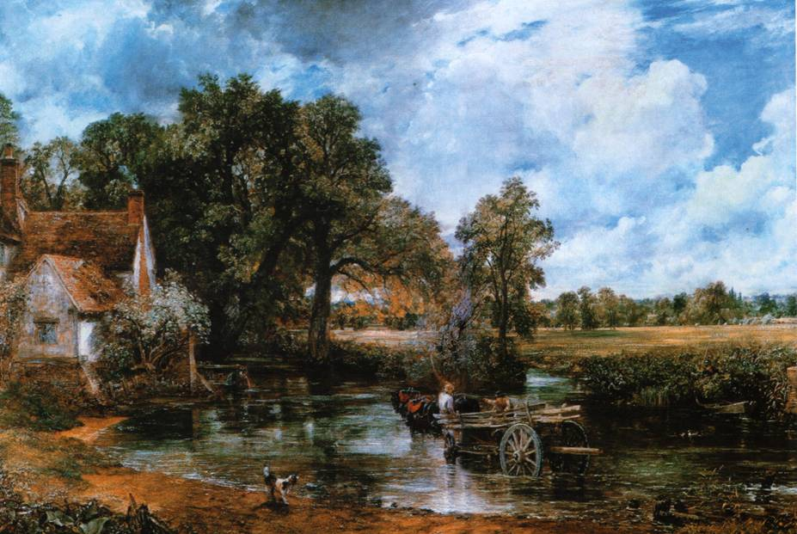
The Hay Wain

Slide 9
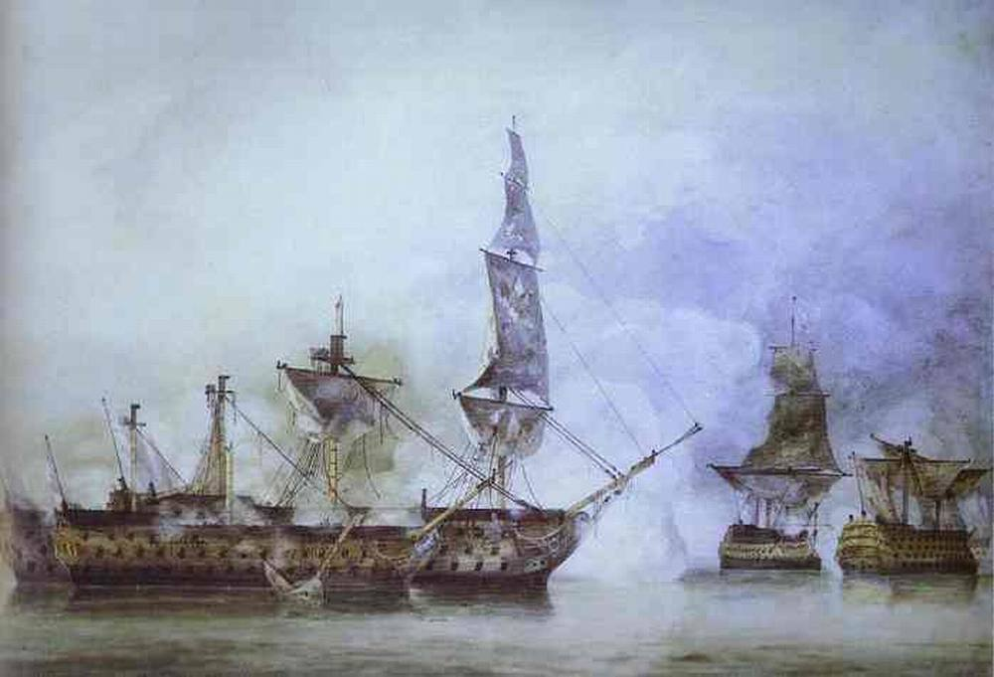
Trafalgar Battle

Slide 10
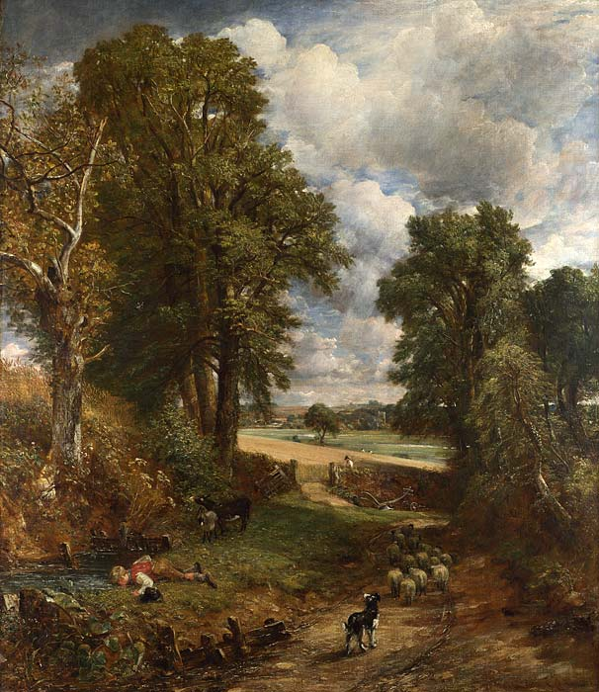
Arable Land

Slide 11
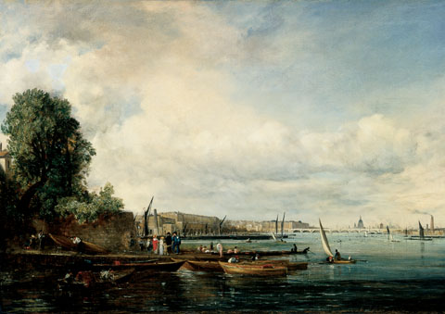
Waterloo Bridge

Slide 12
Thanks for your attention!

