Slide 1
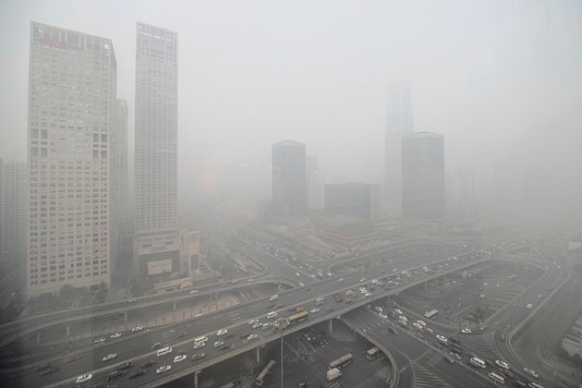
Clean Sky Energy Combustion Technology

Slide 2
CURRENT STATUS OF THE PROJECT
In 2016, the first stage of the international certification of the CS1 catalyst was completed and the technology of its application for coal- and wood pellets-fired boilers of low and medium power was developed.
It was experimentally proved that here is the 10-fold decrease of the CO level while maintaining the catalyst activation level for more than 3 months (without additional reagent in the combustion chamber).
Scientific-laboratory complex for testing new techniques and technologies CSE has been brought into the operation at the plant of the company «Baltkotlomash» in St. Petersburg.

Slide 3
Catalytic Combustion Process
Clean Sky Catalytic Combustion
Effects
Conclusion
Clean Sky Laboratories
Principal Directions

Slide 4
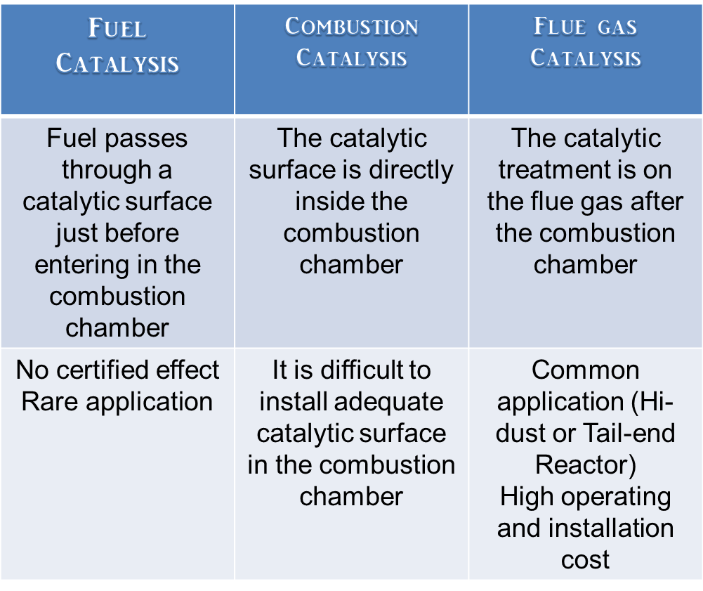
The three basis of the catalytic combustion

Slide 5
Catalytic Combustion Process
Clean Sky Catalytic Combustion
Effects
Conclusion
Clean Sky Laboratories
Principal Directions

Slide 6
CURRENT STATUS OF THE PROJECT
Clean Sky Energy powder catalysts can be injected directly in the combustion chamber of any powering technology (combustion chamber, stroke motor, turbine, gasificator) to get a direct catalysis in the combustion process.

Slide 7
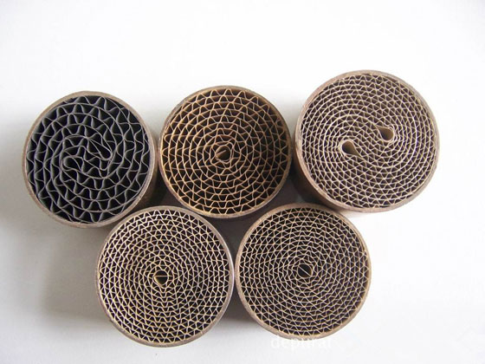
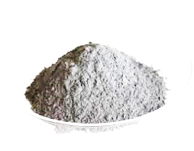
CLEAN SKY CATALYTIC COMBUSTION
Clean Sky Catalytic System
is a complete integration system
catalyzing a boiler with no aggressive
catalytic powder

Slide 8
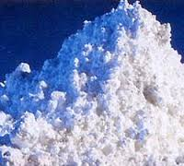
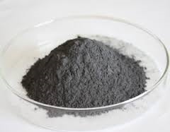
CLEAN SKY CATALYTIC COMBUSTION
Three new genaration of catalytic powders
non-explosive, acid or caustic powders
non-aggressive for the boiler
no heavy metals content
no continuous feeding
not changing slag/ash destination

Slide 9
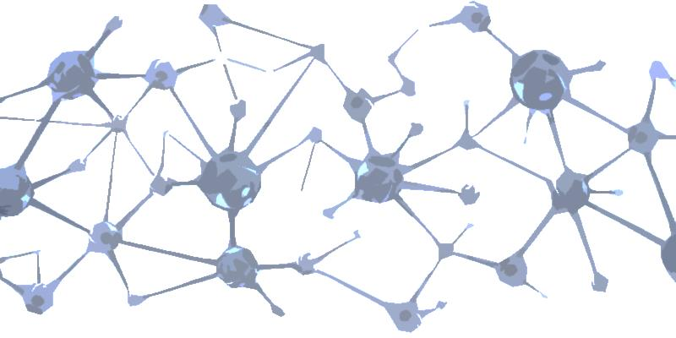
CLEAN SKY CATALYTIC COMBUSTION
The core of Clean Sky Technology is a unique post-treatment of catalyst.
This technology togheter with our qualified mineralogical expertise allows a new generation of green and cheap
direct combustion catalyst.

Slide 10
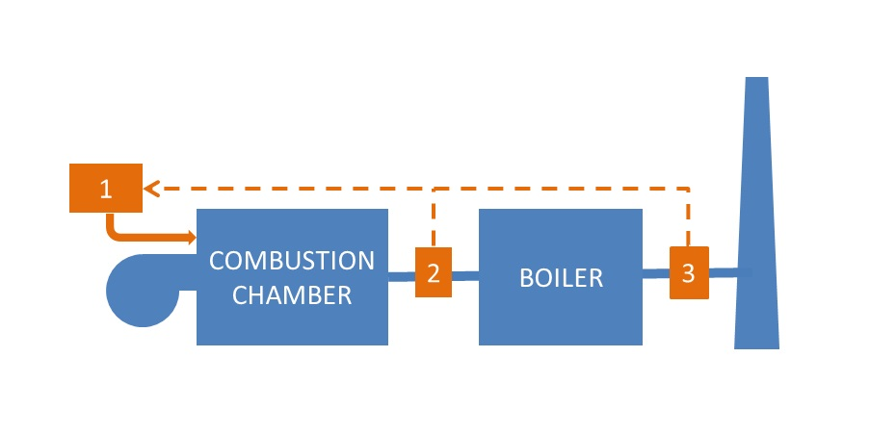
CLEAN SKY CATALYTIC COMBUSTION
Easy-installing component
(1) Doser
(2) Post reactor
(3) CO/NOx Meter

Slide 11
Catalytic Combustion Process
Clean Sky Catalytic Combustion
Effects
Conclusion
Clean Sky Laboratories
Principal Directions

Slide 12
EFFECTS

Slide 13
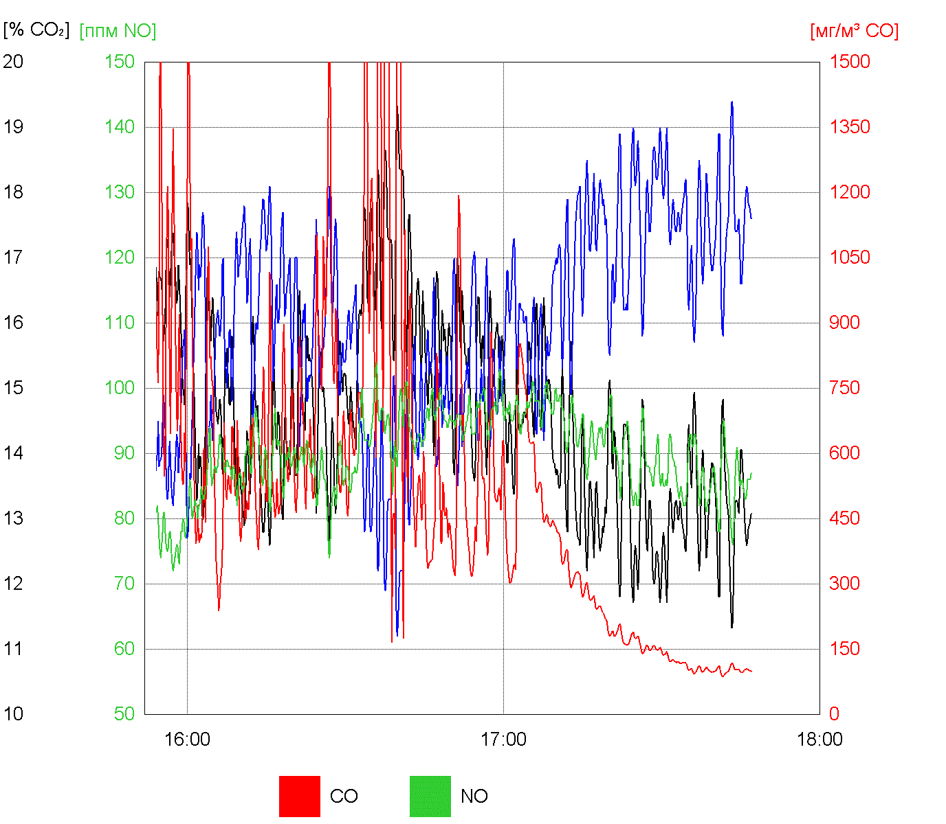
EFFECTS
Direct effect:
CO reduction (5-10 times less)
Air access reduction (20%-30% less)
Flash point and Combustion temperature reduction (from 200 to 400°C less)
Coal burning in extra low air access (λ=1,2)
(commercial boiler, grid combustion, water-cooled combustion chamber)
The combustion is out of control, CO concentration range is from 300 to 2500 mg/Nmc (with medium value of 500 mg/Nmc)
At 17:00, the Catalytic Combustion System with fast reduction and the stabilization of CO emission to 100 mg/Nmc are started.

Slide 14
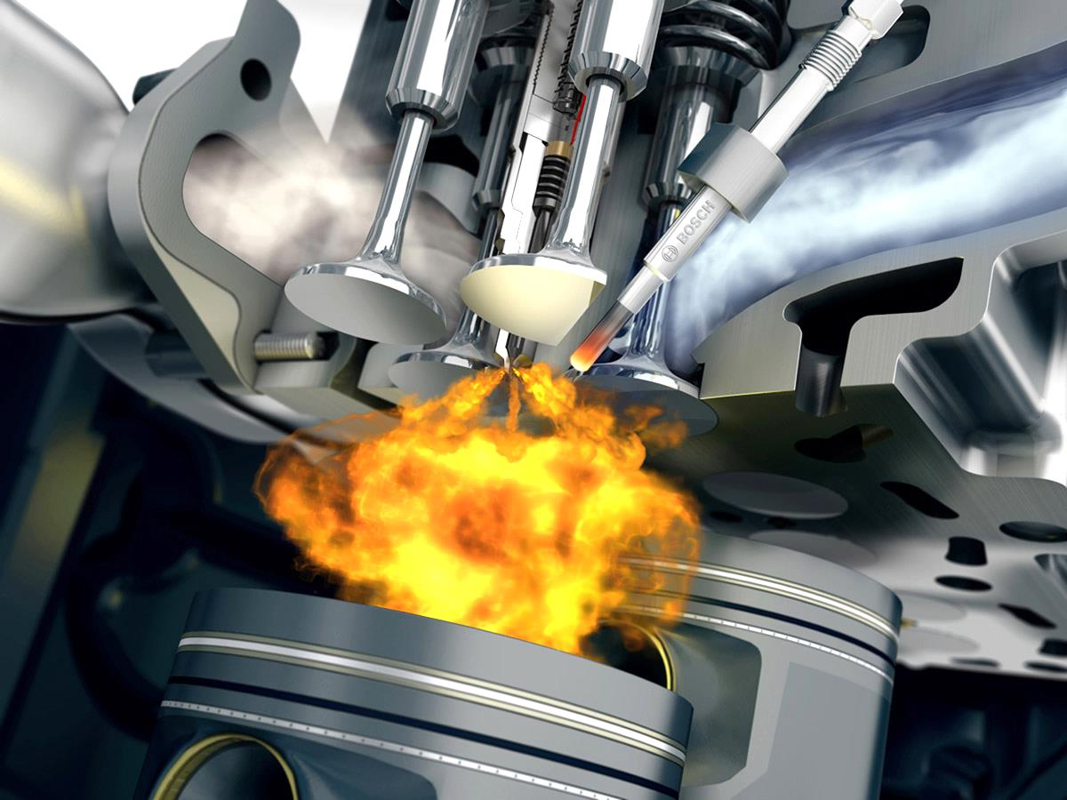
EFFECTS
Indirect effect:
Boiler performance increase
Thermal NOx reduction
Improvement of new emission performance in old boiler
Complete combustion of difficult fuels
Complete combustion in adverse conditions (e.g. small combustion chamber, low turbulence combustion chamber, etc.)

Slide 15
Catalytic Combustion Process
Clean Sky Catalytic Combustion
Effects
Conclusion
Clean Sky Laboratories
Principal Directions

Slide 16
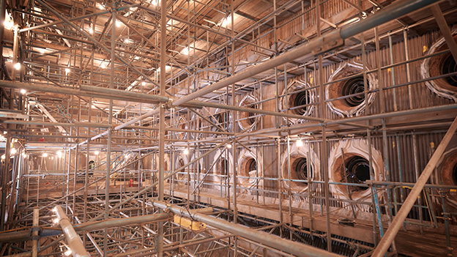
CONCLUSION
Clean Sky Energy
direct combustion catalysis
=
cheap option for
Old Boiler upgrading
(emission and efficiency upgrading)

Slide 17
Catalytic Combustion Process
Clean Sky Catalytic Combustion
Effects
Conclusion
Clean Sky Laboratories
Principal Directions

Slide 18
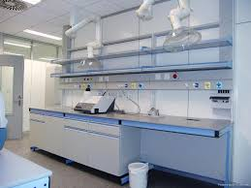
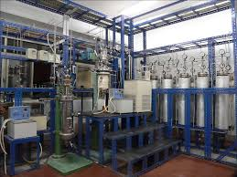
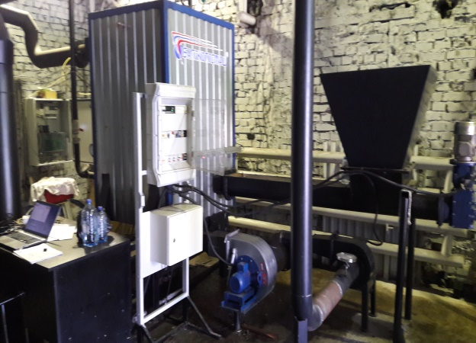
CLEAN SKY LABORATORIES
Chemical laboratory
Catalyst production laboratory
Testing laboratories equipped
with special and commercial boilers

Slide 19
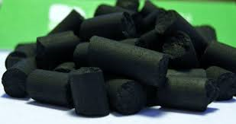
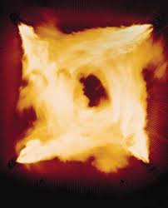
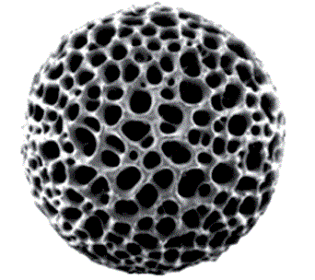
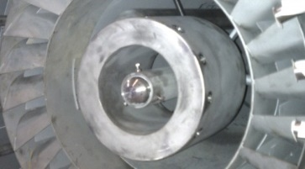
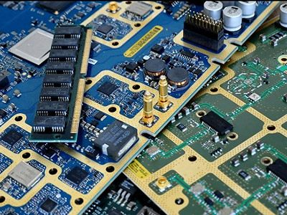
CLEAN SKY LABORATORIES
Other Clean Sky Technologies in process in collaboration with our leading technology Partners:
Clean coal briquette
Micro coal burner
High dust Micro reactor
Catalytic extra-low NOx burner
Recovery metal purification

Slide 20
Catalytic Combustion Process
Clean Sky Catalytic Combustion
Effects
Conclusion
Clean Sky Laboratories
Principal Directions

Slide 21
PRINCIPAL DIRECTION OF THE PROJECT IMPLEMENTATION
Creation of industrial complexes for the production of smokeless high-energy cast from brown coal «Сlean Coal Briquette».
The development of the technology of preparation and incineration of the activated mixture of coal dust and catalyst before its entering the combustion chamber for large and medium-sized coal-fired TPP and CHPP (more than 100 MW).

Slide 22
Clean Sky Energy
CLEAN SKY ENERGY LP
15 BELL STREET
ST ANDREWS
SCOTLAND

Slide 23
Thank You for Your Attention

