Slide 1
Efficient logistic and packaging solution
for your product

Slide 2
We help your company to reach:
Best Packaging:
Preparation of drawings and specs of pack concept for your product
Consultation about optimal pack solution for concept of your product
Calculation necessary parameters of your pack due to transport waste avoidance.
Smart selection of pack materials (balance between cost and properties)
Efficient logistic parameters:
Calculation of best consumer pack solution
Calculation of optimal shipment pack
Calculation the range of optimal palletizations schemes
Calculation of scheme palletizations (optimal number of layers depends on product and transport parameters)

Slide 3
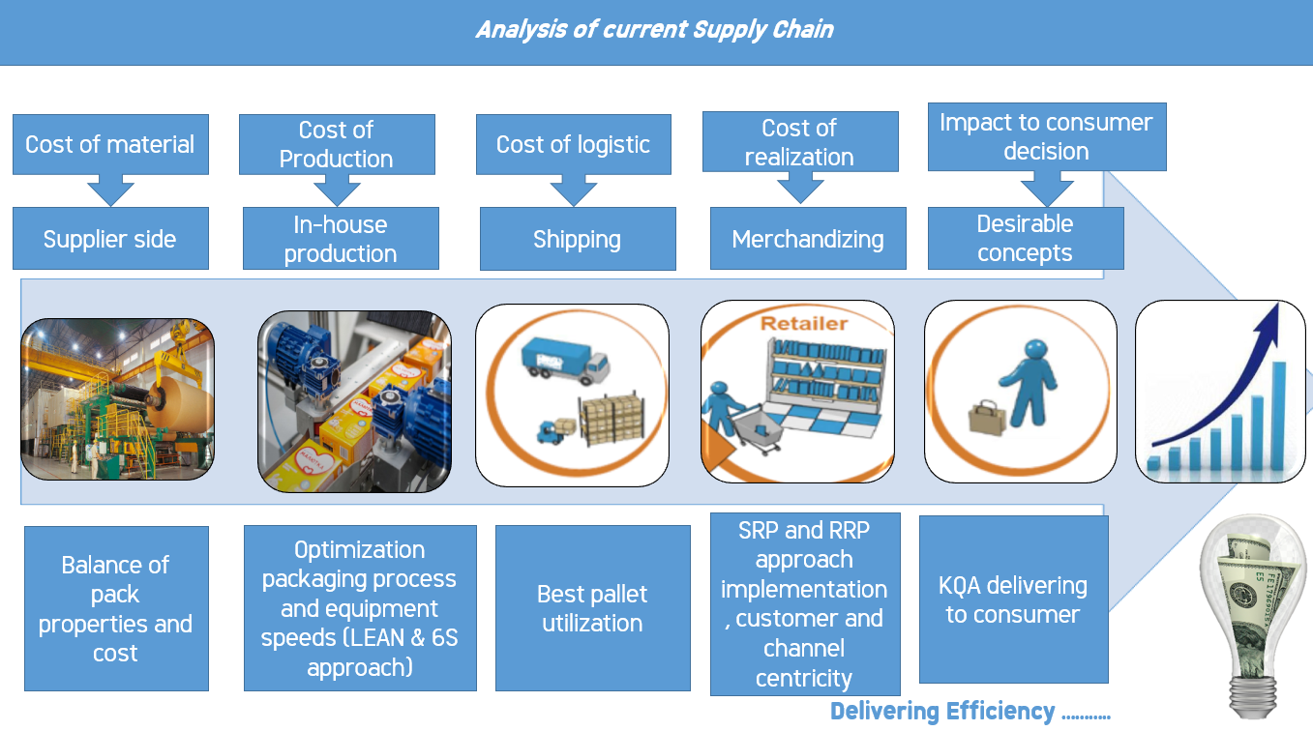
Development new packaging solutions.
Development optimal logistic schemes.
Optimize current logistic schemes.

Slide 4
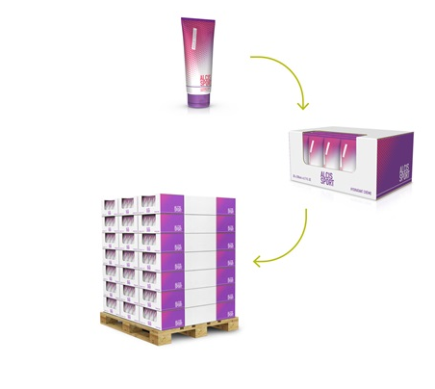
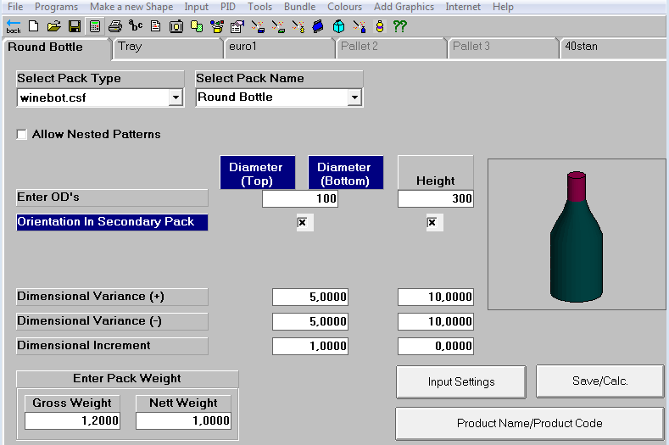
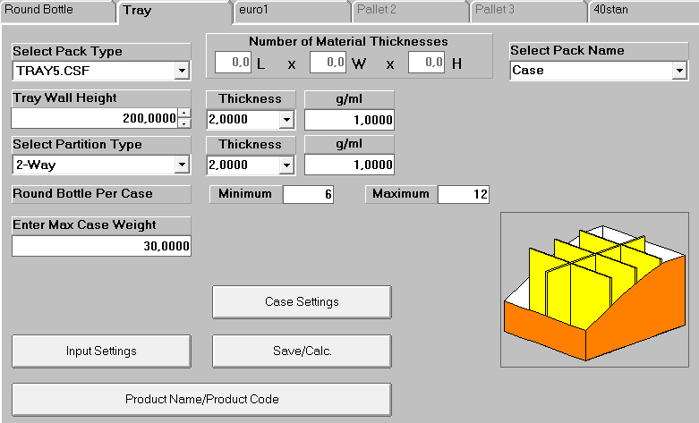
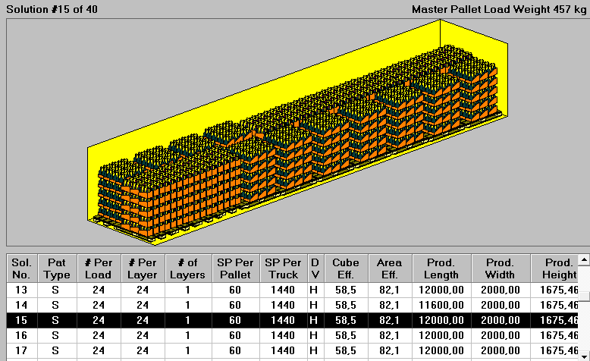
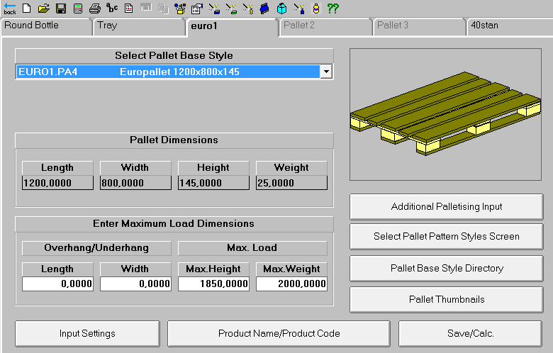
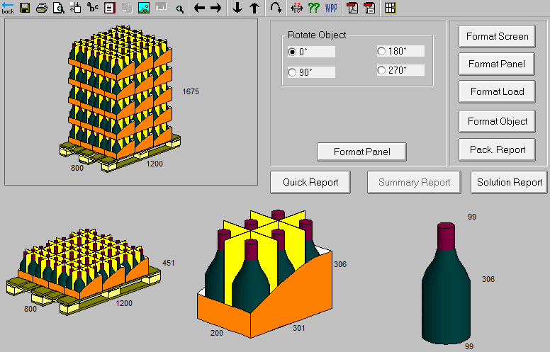
Development from your product to logistics unit

Slide 5
1. You provide us with parameters of your product
3. You deliver your product in safety and cost efficient model
2. On the base of your needs we developed pack and logistic solutions

Slide 6
Delivering Efficiency and Quality
“Alone we can do so little, together we can do so much”

